Slide 1
הרצאה 1
High Level Language
מעבדה במחשבים מחומרה לתוכנה
קורס 10083
אריק גיספאן arikgi@post.jce.ac.il

Slide 2
Where we are at:
Human
Abstract design
Software
Thought
abstract interface
hierarchy
Chapters 9, 12
H.L. Language
Compiler
&
abstract interface
Operating Sys.
Chapters 10 - 11
Virtual
VM Translator
Machine
abstract interface
Chapters 7 - 8
Assembly
Language
Assembler
Chapter 6
abstract interface
Computer
Machine
Architecture
Language
abstract interface
Chapters 4 - 5
Gate Logic
Hardware
abstract interface
Platform
Chapters 1 - 3
Electrical
Hardware
Chips &
Engineering
Logic Gates
Physics
hierarchy

Slide 3
The OO approach to programming
Object = entity associated with properties (fields) and operations (methods)
Objects are instances of classes E.g. bank account, employee, transaction, window, gameSession, …
OO programming: identifying, designing and implementing classes
“Static class”: a collection of static methods.
Notes:
שפת תכנות מונחה עצמים –
מה זה אובייקט?
מה ההבדל בין אובייקט למחלקה?
תכנות מ"ע – הגדרה תכנון ומימוש
מחלקה סטטית?

Slide 4
Disclaimer
Although Jack is a real programming language, we don’t view it as an end
Rather, we view Jack as a means for teaching
How to build a compiler
How the compiler and the language interface with the OS
How the topmost piece in the software hierarchy fits into the picture
Jack can be learned (and un-learned) in one hour.
Notes:
ג'ק לא שפת קצה באמת
בניית מחשב, קומפילציה ומערכת הפעלה, החלק האחרון בפאזל

Slide 5
Example 0: hello world
/** Hello World program. */
class Main {
function void main() {
/* Prints some text using the standard library. */
do Output.printString(”Hello World”);
do Output.println(); // New line
return;
}
}
Java-like syntax
Comments
Standard library.

Slide 6
Example 0: hello world
Primitive data types: int,char,boolean
Method (non-static) and function (static)
Variables: var (local- stack), static, field, parameter(only in argument)
Let – assignment, do – void call to a subroutine
Flow - If,else,while,return
Constants – true,false,null
This – reference to current object (last call with Memory.deAlloc(this) )
Objects, arrays
Operator priority – not defined!!! (2*3+5 result undefined)

Slide 7
Example 1: procedural programming
class Main {
/* Sums up 1 + 2 + 3 + ... + n */
function int sum(int n) {
var int i, sum;
let sum = 0;
let i = 1;
while (~(i > n)) {
let sum = sum + i;
let i = i + 1;
}
return sum;
}
function void main() {
var int n, x;
let n = Keyboard.readInt("Enter n: ");
let x = Main.sum(n);
do Output.printString("The result is: ");
do Output.printInt(sum);
do Output.println();
return;
}
} // Main
Jack program = collection of one or more classes
Jack class = collection of one or more subroutines
Jack subroutine:
Function (static)
Method (non static)
Constructor
(the example on the left has functions only, as it is “object-less”)
There must be at least one class named Main, and one of its methods must be named main.

Slide 8
Example 2: OO programming
class BankAccount {
static int nAccounts;
// account properties
field int id;
field String owner;
field int balance;
/* Constructs a new bank account. */
constructor BankAccount new(String aOwner) {
let id = nAccounts;
let nAccounts = nAccounts + 1;
let owner = aOwner;
let balance = 0;
return this;
}
// ... More BankAccount methods.
} // BankAccount
...
var int sum;
var BankAccount b, c;
let b = BankAccount.new(”Joe”);
...
Notes:
Non static class has fields – internal state , and a constructor
מה ההבדל בין bankaccount ל b ?

Slide 9
Example 2: typical OO programming (cont.)
class BankAccount {
static int nAccounts;
// account properties
field int id;
field String owner;
field int balance;
// Constructor ... (omitted)
/* Deposits money in this account. */
method void deposit(int amount) {
let balance = balance + amount;
return;
}
/* Withdraws money from this account. */
method void withdraw(int amount){
if (balance > amount) {
let balance = balance - amount;
}
return;
}
// ... More BankAccount methods.
} // BankAccount
...
var int sum;
var BankAccount b, c;
let b = BankAccount.new("Joe");
do b.deposit(5000);
let c = BankAccount.new("jane");
let sum = 1000;
do b.withdraw(sum);
...
Notes:
The internal state (fields) are changed only throuh methods

Slide 10
Example 2: typical OO programming (cont.)
class BankAccount {
static int nAccounts;
// account properties
field int id;
field String owner;
field int balance;
// Constructor ... (omitted)
/* Prints information about this account. */
method void printInfo() {
do Output.printInt(ID);
do Output.printString(owner);
do Output.printInt(balance);
return;
}
/* Destroys this account. */
method void dispose() {
do Memory.deAlloc(this);
return;
}
// ... More BankAccount methods.
} // BankAccount
...
var int sum;
var BankAccount b, c;
let b = BankAccount.new("Joe");
// manipulates b...
do b.printInfo();
do b.dispose();
...
Notes:
After using an object you must free its memory with dispose (destructor)

Slide 11
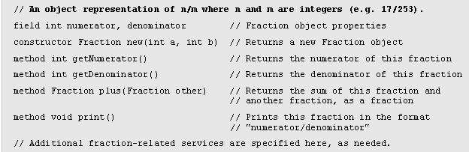
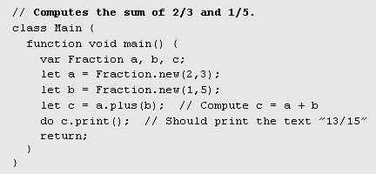

Example 3: abstract data types (API + usage)
Motivation: Jack has three primitive data types: int, char, boolean
Fraction API
Using the Fraction API (example)
API = public contract
Interface / implementation.
Notes:
You can extend the data types
The given API can be viewed either as a manual or a contract

Slide 12
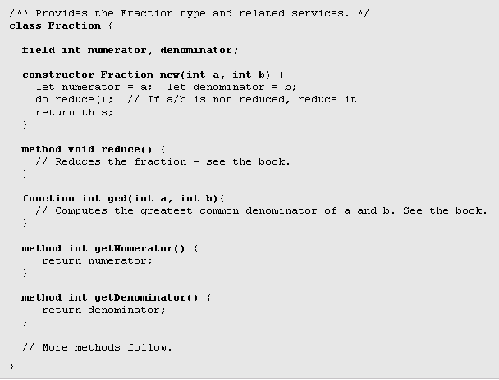
Example 3: abstract data types (implementation)
Notes:
The fraction class (partial) implementation

Slide 13
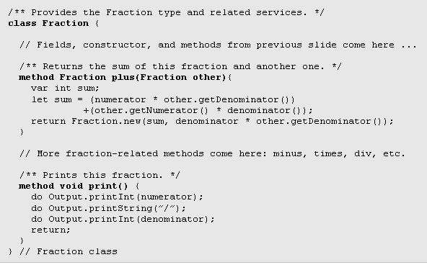
Example 3: abstract data types (implementation cont.)

Slide 14
Example 4: linked list
/** Represents a linked list. */
class List {
field int data;
field List next;
/* Creates a new List object. */
constructor List new(int car, List cdr) {
let data = car;
let next = cdr;
return this;
}
/* Disposes this List by recursively disposing its tail. */
method void dispose() {
if (~(next = null)) {
do next.dispose();
}
do Memory.deAlloc(this);
return;
}
...
} // class List.
class Foo {
...
// Creates a list holding the numbers (2,3,5).
function void create235() {
var List v;
let v = List.new(5,null);
let v = List.new(2,List.new(3,v));
...
}
Notes:
Another example for a list

Slide 15
Jack language specification
Syntax
Data types
Variable kinds
Expressions
Statements
Subroutine calling
Program structure
Standard library
(for complete language specification, see the book).

Slide 16
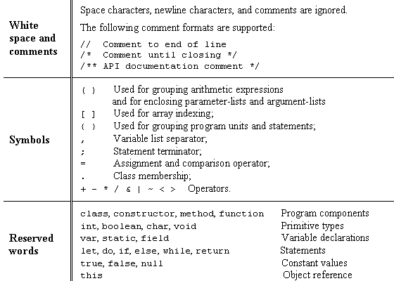
Jack syntax

Slide 17
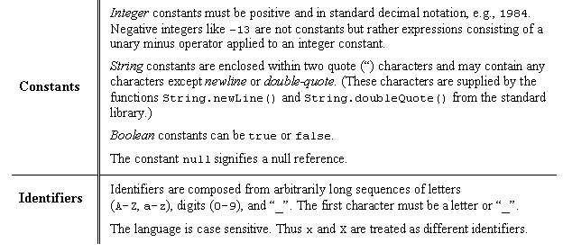
Jack syntax (cont.)

Slide 18
Jack data types
Primitive types:
Int 16-bit 2’s complement (15, -2, 3, ...)
Boolean 0 and –1, standing for true and false
Char unicode character (‘a’, ‘x’, ‘+’, ‘%’, ...)
Abstract data types (supplied by the OS or by the user):
String
Fraction
List
. . .
Application-specific types:
BankAccount
Bat / Ball
. . .

Slide 19
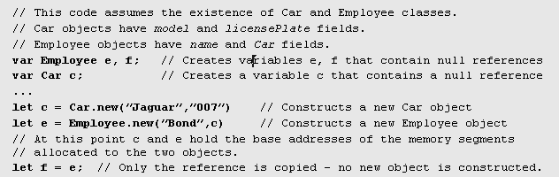
Jack data types: memory allocation
Object types are represented by a class name and implemented as a reference, i.e. a memory address
Memory allocation:
Primitive variables are allocated memory space when they are declared
Object variables are allocated memory space when they are created via a constructor.

Slide 20
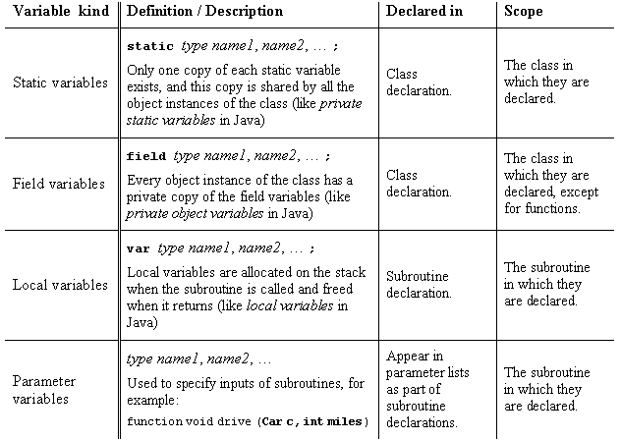
Jack variable kinds and scope

Slide 21
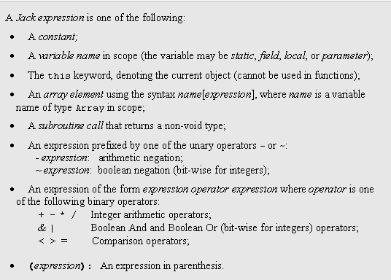
Jack expressions
No operator priority!

Slide 22
Jack Statements
let variable = expression;
or
let variable [expression] = expression;
if (expression) {
statements
}
else {
statements
}
while (expression) {
statements
}
do function-or-method-call;
return expression;
or
return;

Slide 23
Jack subroutine calls
General syntax: subroutineName(arg1, arg2, …)
Each argument is a valid Jack expression
Parameter passing is by value (primitive types) or by reference (object types)
Example: suppose we have function int sqrt(int n)
This function can be invoked as follows:
sqrt(17)
sqrt(x)
sqrt(a*c-17)
sqrt(a*sqrt(c-17)+3)
Etc.

Slide 24
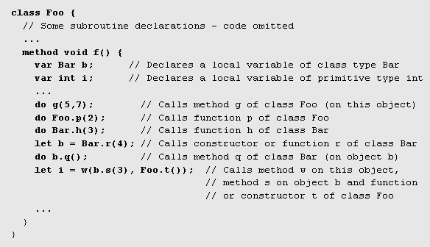
Jack subroutine calls (cont.)

Slide 25
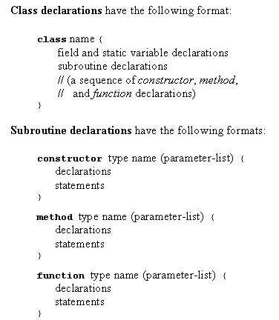
Jack program structure
Each class in a separate file (compilation unit)
Jack program = collection of classes, containing a Main.main().

Slide 26
Jack standard library = language extensions = OS
class Math {
function void init()
function int abs(int x)
function int multiply(int x, int y)
function int divide(int x, int y)
function int min(int x, int y)
function int max(int x, int y)
function int sqrt(int x)
}
Class String {
constructor String new(int maxLength)
method void dispose()
method int length()
method char charAt(int j)
method void setCharAt(int j, char c)
method String appendChar(char c)
method void eraseLastChar()
method int intValue()
method void setInt(int j)
function char backSpace()
function char doubleQuote()
function char newLine()
}
Class Array {
function Array new(int size)
method void dispose()
}
class Output {
function void moveCursor(int i, int j)
function void printChar(char c)
function void printString(String s)
function void printInt(int i)
function void println()
function void backSpace()
}
Class Screen {
function void clearScreen()
function void setColor(boolean b)
function void drawPixel(int x, int y)
function void drawLine(int x1, int y1, int x2, int y2)
function void drawRectangle(int x1, int y1, int x2, int y2)
function void drawCircle(int x, int y, int r)
}
class Memory {
function int peek(int address)
function void poke(int address, int value)
function Array alloc(int size)
function void deAlloc(Array o)
}
Class Keyboard {
function char keyPressed()
function char readChar()
function String readLine(String message)
function int readInt(String message)
}
Class Sys {
function void halt():
function void error(int errorCode)
function void wait(int duration)
}

Slide 27
Perspective
Jack is an object-based language: no inheritance
Primitive type system
Standard library
Our hidden agenda: gearing up to understand how to develop the ...
Compiler
OS

